Slide 1
REVISTING THE INTERACTION OF A CATIONIC DYE WITH CHEMICALLY MODIFIED GRAPHENE SHEETS
Name: Varun Dolia
Discipline: Materials Science and Engineering
Supervisor: Dr. Kabeer Jasuja
Notes:
Thanks to Sir, Asha, Satadru

Slide 2
Outline of the Presentation Ahead
Revisiting the phenomenon of Dye Adsorption on Graphene Oxide
What led us to explore?
An unexpected set of observations in the UV-Vis absorption spectra of the dye molecules in the presence of nanosheets
How did we study it?
UV-Vis Spectroscopy
Notes:
The peculiar set of observations made us look into different systems than our boron based nanosheets and thus we tried similar experiments with GO nanosheets

Slide 3
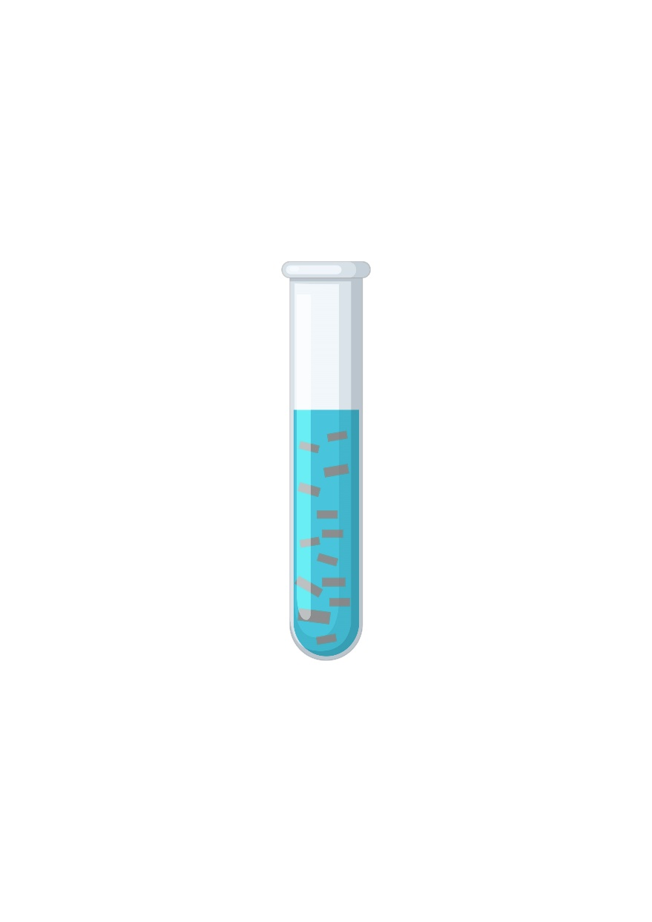
Graphene Oxide as an adsorbent
Methylene Blue
Nanosheets are few layers of atom thick.
Provides higher surface area (Honeycomb Structure)
Ionizes and gives a net negative charge because of various oxy functional groups on GO Nanosheets
Graphene oxide (GO) disperses pretty well in an aqueous medium
One important traditional application is adsorption
Large concentration of oxide groups promote adsorption of cationic molecules due to electrostatic attraction.
In case of MB, due to presence of aromatic rings, adsorption also takes place through pi-pi stacking.
Graphene Oxide

Slide 4




Traditionally, Adsorption Experiments are performed like……
Aqueous GO suspension added
Centrifugation
Adsorbed MB on GO
nanosheets settle
at the bottom
Supernatant separated out
Aqueous MB Solution
GO Disperses and
Adsorption Starts
MB adsorbs on
GO nanosheets
UV-Vis Spectroscopy

Slide 5
How did we perform the experiment…
Aqueous GO suspension added
Curious to check, what would happen if we don’t perform the centrifugation
Studied the UV-Vis spectra in the presence of the GO nanosheets (An operando approach)
Aqueous MB Solution
GO Disperses and
Adsorption Starts
MB adsorbs on
GO nanosheets
UV-Vis Spectroscopy
Notes:
The purpose was to check what would happen if we keep the GO sheets within the system.
As a result, the peculiar behaviour stated earlier was only observed after this

Slide 6
Subtracting the GO Signature
Regular UV-Vis spectra were recorded
GO’s signature was subtracted to capture only the signatures of MB

Slide 7
What made us Curious?
At 0 ppm GO i.e. only MB, two peaks observed (Signature of MB). One corresponding to monomer and the other corresponding to dimer.
At a higher concentration of GO, more than two peaks are observed, despite of keeping the concentration of MB the same. This was unintended and unexpected.
This helped us envision a possibility of more than just two species.
Thought of deconvouting the curves to check its constituents

Slide 8
On Deconvoluting
Deconvolution was used to find the constituent curves of the GO-MB spectra
On deconvoluting, indeed more than two constituent curves are observed at higher GO concentrations
Each constituent curve corresponds to different species
As found in literature:
Free Monomer – peak at ~664 nm (Blue)
Free Dimer – peak at ~620 nm (Orange)
Adsorbed Monomer – peak at ~675 nm (Purple)
Adsorbed Dimer – peak at ~595 nm (Green)
Similarly, performed experiments by varying concentration of GO from 0ppm to 150 ppm, keeping MB concentration constant at 10, 7.5 and 5 ppm (one at a time for all conc. Of GO)
Cenens, J., & Schoonheydt, R. A. (1988). Visible spectroscopy of methylene blue on hectorite, laponite B, and barasym in aqueous suspension. Clays and Clay Minerals, 36(3), 214-224.
Notes:
How do we know which peak corresponds to which species?.... this is understood by checking the wavelength at which we get the peak...and each specie gets a peak at a different wavelength

Slide 9
Notes:
Now I'll show you some of the curves at various GO concentrations....I would like you to pay attention to the various species which come up at different concentrations

Slide 14
GO: 120 ppm

Slide 16
Deconvoluted Graphs → Scatter Plots
Tabulated the Peak/Absorbance value for each deconvoluted constituent curve
Scatter plots made from these tables to study the behaviour of individual species with increasing GO concentration
Four different species were tracked:
Free monomer
Free dimer
Adsorbed monomer
Adsorbed dimer
Peak corresponding to individual species were identified by the wavelength at which absorbance appears.
Cenens, J., & Schoonheydt, R. A. (1988). Visible spectroscopy of methylene blue on hectorite, laponite B, and barasym in aqueous suspension. Clays and Clay Minerals, 36(3), 214-224.
Notes:
Give an example of dimers to explain... that we know that its peak comes at 620 nm... now at each conentration of go, on deconvoluting, we find its absorbance value and tabulate it across the concetration of GO.
We then plotted the two species of monomers in one graph and two of dimers in another to understand, how monomers behave as a whole and similarly how dimers behave as a whole

Slide 17
On changing the concentration of MB
MB: 10 ppm
MB: 7.5 ppm
MB: 5 ppm
Monomers
Dimers
Combined
Notes:
We are currently in process of understanding these trends

Slide 18
Implication
Present Understanding
MB adsorbs on GO nanosheets
No clarification on how individual species of MB are adsorbing
Improved Understanding
(based on this work)
Simultaneous adsorption of Monomers and Dimers of MB
Monomers and Dimers adsorb in different manners
These adsorption trends depend on concentration of MB & GO
Notes:
Literature doesn't state how the trend is different for both monomers and dimers
They only state that adsorption is taking place and with introdcution of GO in the system of MB, the equilibrium between monomers and dimers is disturbed

Slide 19
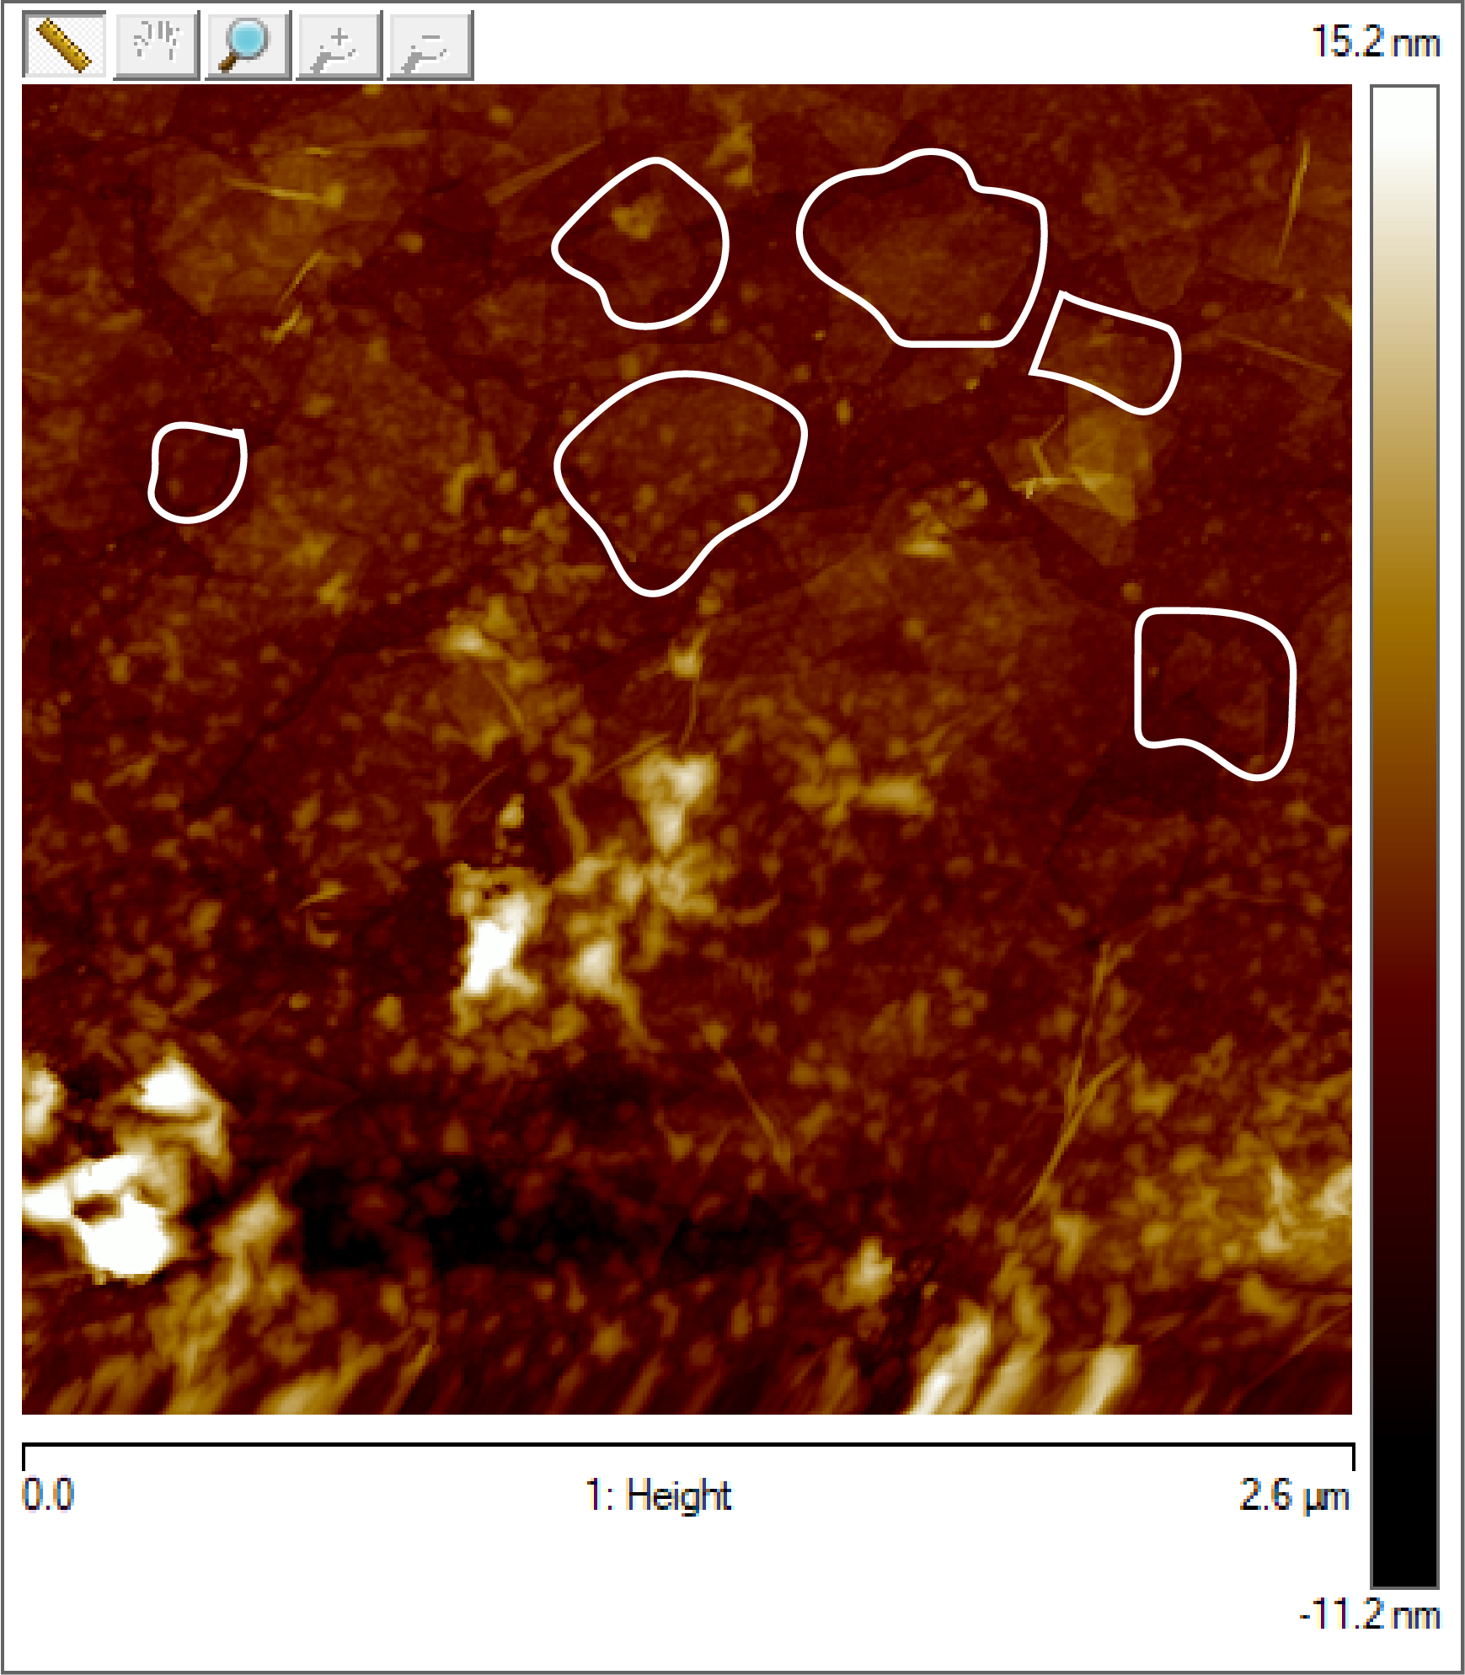
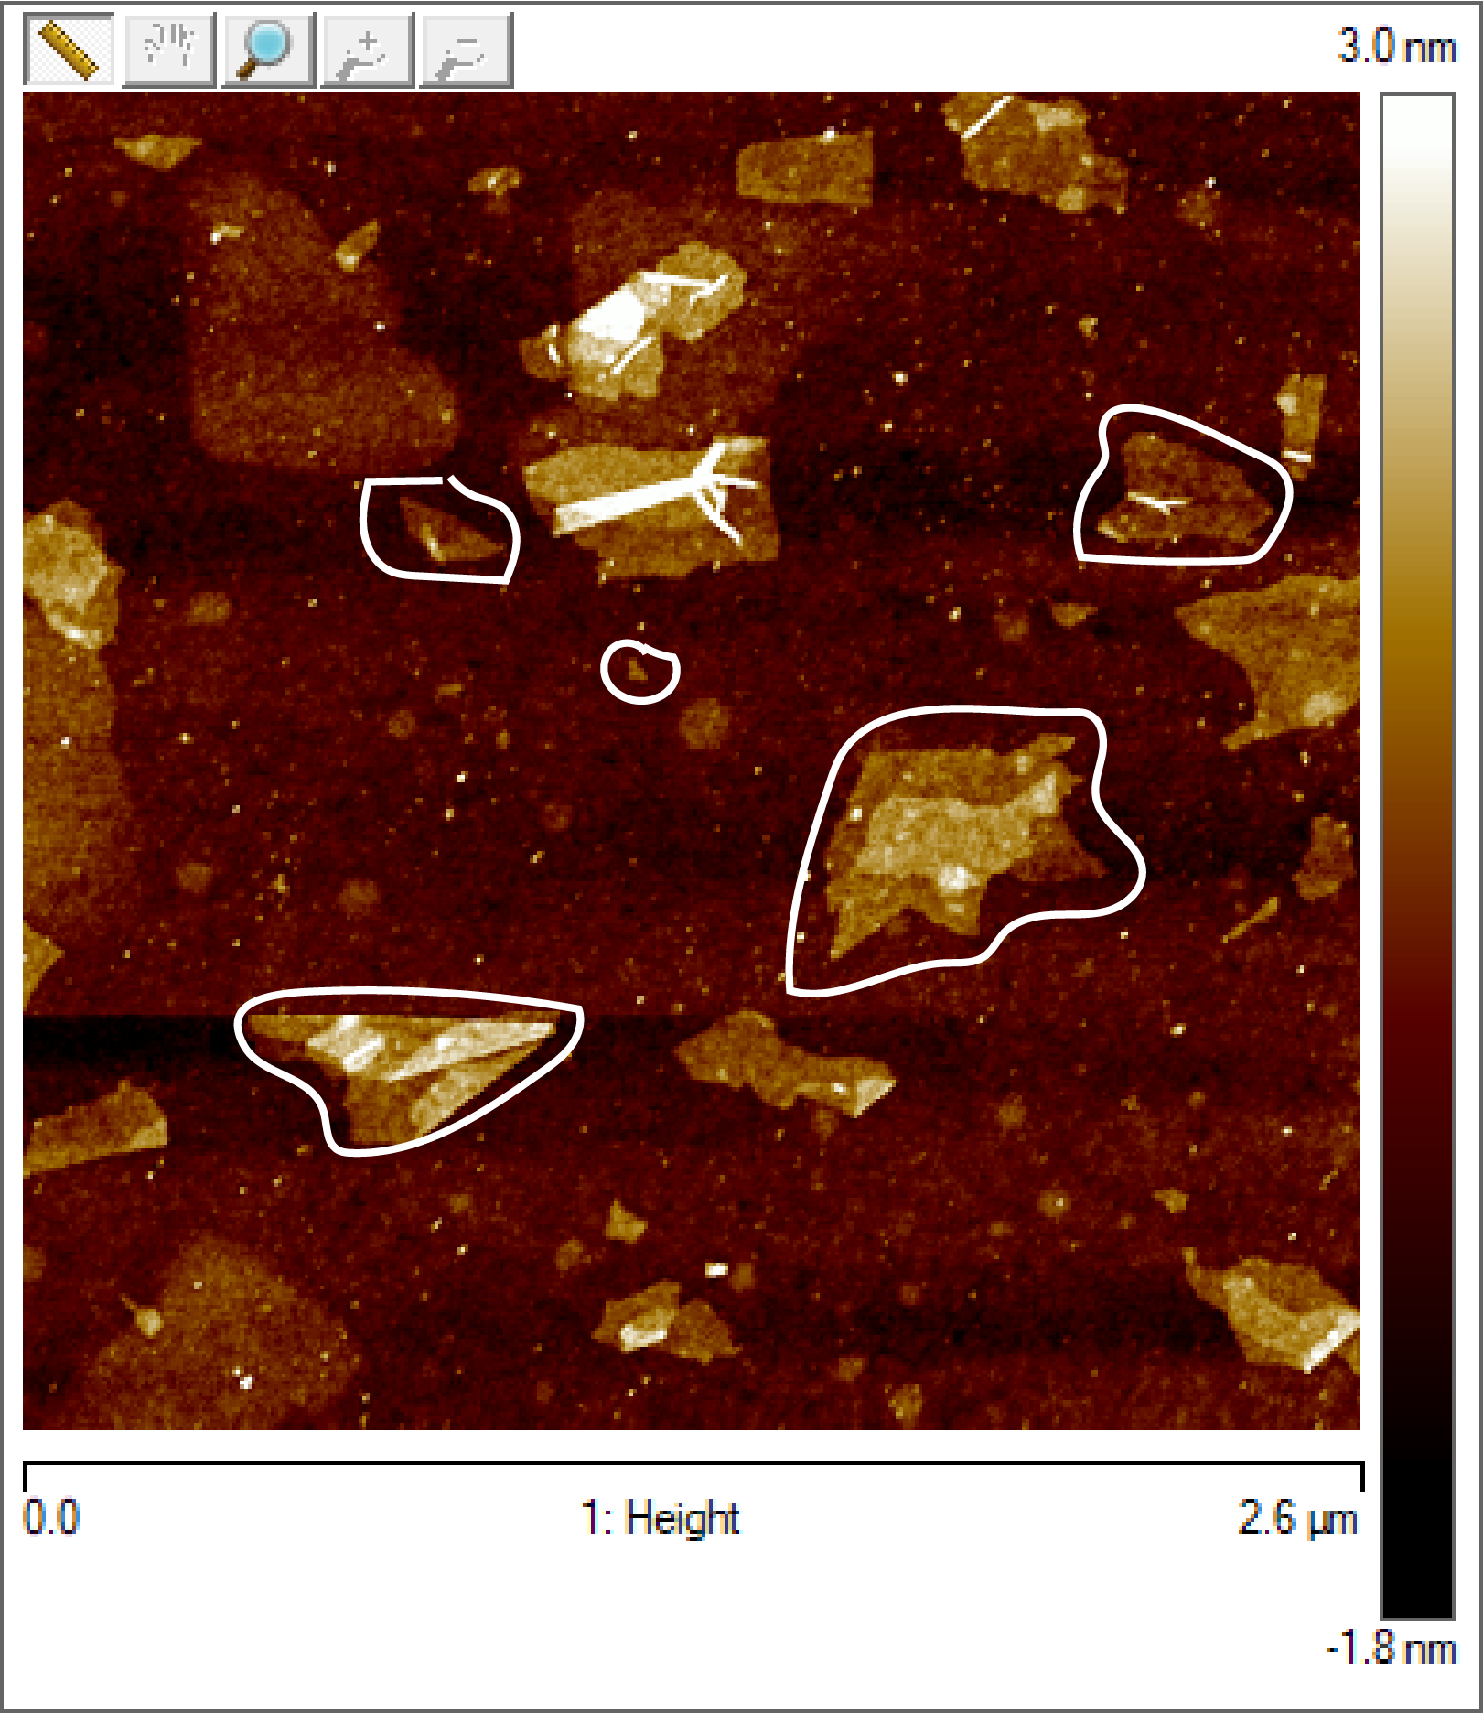
Plans Ahead…
Need to check into other UV-Vis Spectra parameters like the width of the Gaussian curves
Can we play around with the degree of adsorption?
We have already tweaked around with the concentrations of MB and GO…..
What would happen if we change the size of our nanosheets !?
AFM iamges of two different GO batches that we synthesised
Avg sizes: 2500 nm, 650 nm
Std. Deviation: 219 nm, 0.002 nm

Slide 20
Plans Ahead…
Is there a better way in which we can convey our findings?
Current Representation
Attempt (tried few days back)

Slide 21
References
Synthesizing Graphene Oxide:
Hummers Jr, W. S., & Offeman, R. E. (1958). Preparation of graphitic oxide. Journal of the american chemical society, 80(6), 1339-1339.
Compton, O. C., Cranford, S. W., Putz, K. W., An, Z., Brinson, L. C., Buehler, M. J., & Nguyen, S. T. (2012). Tuning the mechanical properties of graphene oxide paper and its associated polymer nanocomposites by controlling cooperative intersheet hydrogen bonding. ACS nano, 6(3), 2008-2019.
Adsorption on Graphene Oxide:
Liu, J., Li, P., Xiao, H., Zhang, Y., Shi, X., Lü, X., & Chen, X. (2015). Understanding flocculation mechanism of graphene oxide for organic dyes from water: Experimental and molecular dynamics simulation. AIP Advances, 5(11), 117151.
Liu, T., Li, Y., Du, Q., Sun, J., Jiao, Y., Yang, G., ... & Zhu, H. (2012). Adsorption of methylene blue from aqueous solution by graphene. Colloids and Surfaces B: Biointerfaces, 90, 197-203.
Şinoforoğlu, M., Gür, B., Arık, M., Onganer, Y., & Meral, K. (2013). Graphene oxide sheets as a template for dye assembly: graphene oxide sheets induce H-aggregates of pyronin (Y) dye. Rsc Advances, 3(29), 11832-11838.
Avena, M. J., Valenti, L. E., Pfaffen, V., & De Pauli, C. P. (2001). Methylene blue dimerization does not interfere in surface-area measurements of kaolinite and soils. Clays and clay minerals, 49(2), 168-173.
Characteristic Spectra of Methylene Blue and its various species:
Heger, D., Jirkovský, J., & Klan, P. (2005). Aggregation of methylene blue in frozen aqueous solutions studied by absorption spectroscopy. The Journal of Physical Chemistry A, 109(30), 6702-6709.
Bergmann, K., & O'konski, C. T. (1963). A spectroscopic study of methylene blue monomer, dimer, and complexes with montmorillonite. The Journal of Physical Chemistry, 67(10), 2169-2177.
Cenens, J., & Schoonheydt, R. A. (1988). Visible spectroscopy of methylene blue on hectorite, laponite B, and barasym in aqueous suspension. Clays and Clay Minerals, 36(3), 214-224.
Spencer, W., & Sutter, J. R. (1979). Kinetic study of the monomer-dimer equilibrium of methylene blue in aqueous solution. Journal of Physical Chemistry, 83(12), 1573-1576.
Heger, D., Jirkovský, J., & Klan, P. (2005). Aggregation of methylene blue in frozen aqueous solutions studied by absorption spectroscopy. The Journal of Physical Chemistry A, 109(30), 6702-6709.

Slide 22
Thank You

